Slide 1
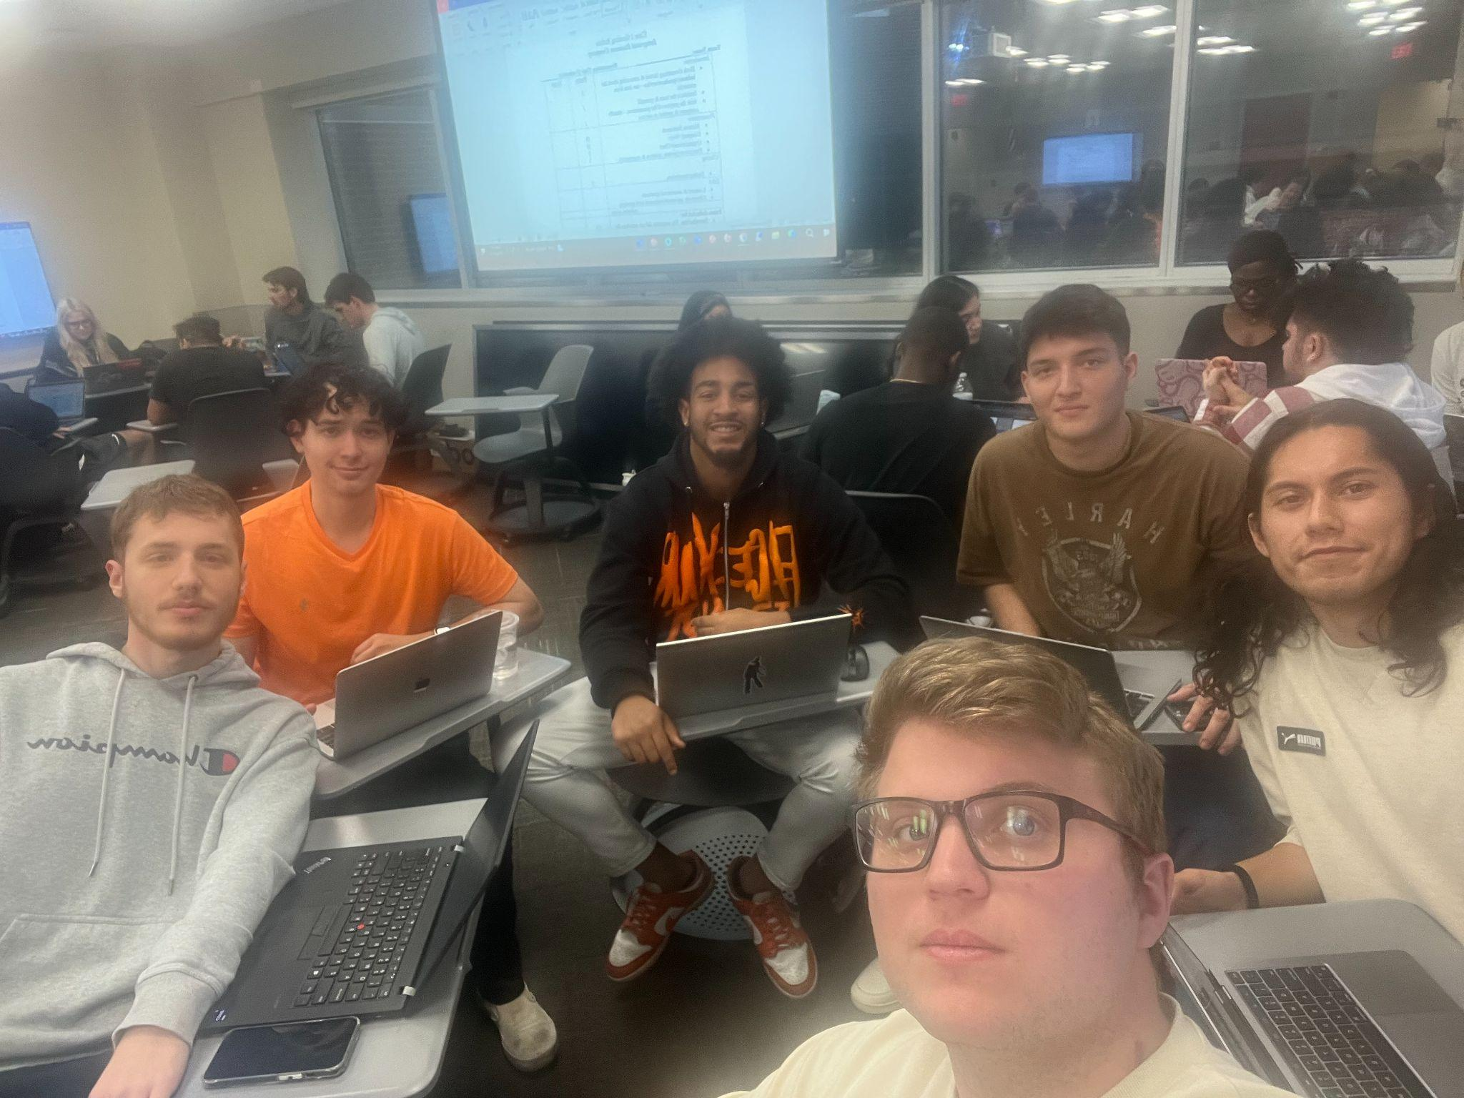
FLOW BTTR
Sales Team #6
Kaeden Fuller, Jeffery Estrada, Steve Gomez, Nicholas Frasca, Joel Mejia
Notes:
Steve

Slide 2
Table Of Contents
• Company Product: Water Filtration System.
• Positioning Statement
• Value Proposition
• Competitive Advantages
• Competitor Analysis
Notes:
Steve

Slide 3
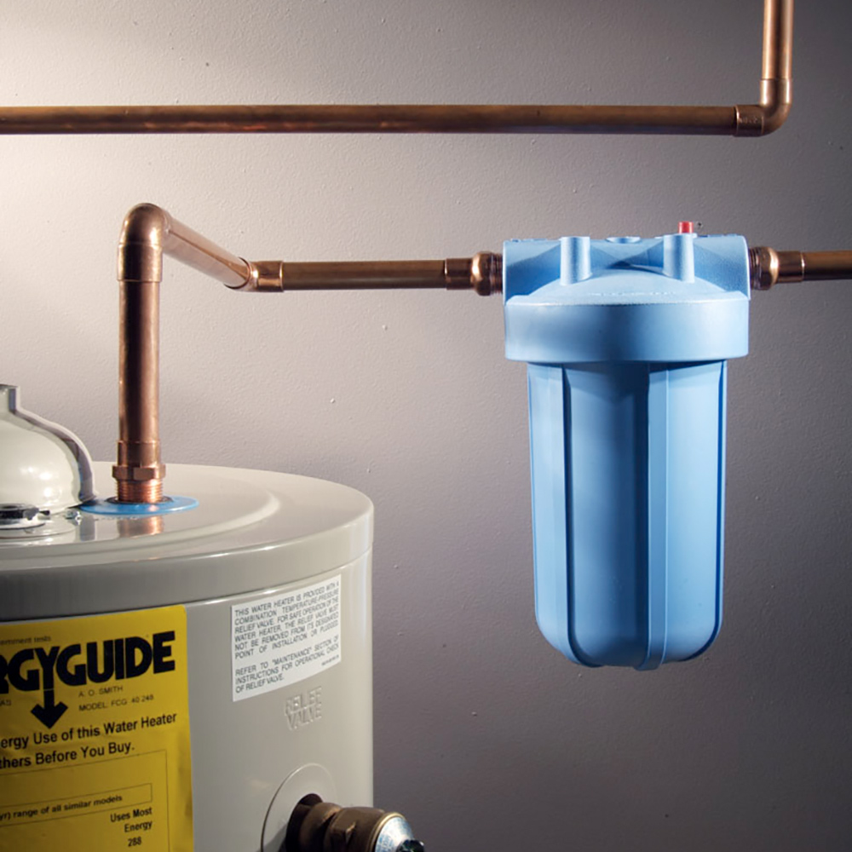
Company Product and Service
FLOW BTTR
Notes:
Steve

Slide 4
Positioning statement
“Cheaper, and cleaner water for businesses”
Filtering oxygen out from the water
Filters any contaminants that pass through pipes
Allows you to pay only for the water you’ve used
Notes:
Kaedon

Slide 5
Value proposition
“Why pay more for unfiltered water, when you could pay less for cleaner water”.
Saves money on water expenses through filtering oxygen
Provides cleaner, more sanitary water for patrons
No upfront cost
Notes:
Kaedon

Slide 6
Competitive advantage
If you see no savings you do not pay
Our filters are not only meant for water treatment but also cutting back on financial waste
No upfront cost
More accurately measures water flow instead of air, providing a true water bill.
Our water pipes contain filtration that improves the water flow through the pipes
This allows for no air to be measured through the pipes, this way you are being charged a true water bill.
a
Notes:
Jeffrey

Slide 7
Competitive advantage (cont.)
We provide easy installation and continuous customer support
Provide replacement filter if any damage occurs
Reliable filters with the guarantee of support
Our system will alert if it senses any abnormalities
Notes:
Nick

Slide 8
Competitor analysis: New Life Water
Based in Orlando,Fl
Offer Filters that deal with Hard water to reduce buildup
Disrupts plumbing and damages appliances
Service the areas of kissimmee, oviedo, winter garden, and much more of the central florida area
Established in 2018
Notes:
Thank you, Nick
Here we have one of our main competitors New Life Water
We both are both in the same market -> The CFL area
There product differs from ours as they with deal hard water build-up, which disrupts plumbing and appliances
I will nowvpass it on to Ajax for the second competitor analysis

Slide 9
Competitor analysis: Store bought filters
Multiple companies sell water filter and systems residentially and commercially
Kinetico, PureWater, etc
These companies typically either focus on brick and mortar locations or on large corporation B2B sales
These types of companies focus on a different market segment that we are targeting
Notes:
Ajax

Slide 10
Conclusion
Save money on water expenses
Provides cleaner water to the system
Easy installation provided with no upfront cost
No savings = don't pay
Notes:
Steve

Slide 11
References
Home Water Filtration Systems: New life water: Orlando, Florida. New Life Water. (n.d.). https://www.newlifewaterllc.com/
New Life Water LLC: Better Business Bureau® profile. BBB. (n.d.). https://www.bbb.org/us/fl/orlando/profile/water-conditioning-contractor/new-life-water-llc-0733-90715870

